Slide 1
Binary Numbers
A supplemental lesson for AP CSP

Slide 2
Warm-up
How many ways can you represent 7?
  Make a list
  Share with a classmate

Slide 3
Activity: Part 1
Today we will find another way to represent 7.
Start by watching this video
  You can watch the entire video (9 min) or the section 1:09-7:32
  Secret Coders video

Slide 4
Activity: Part 2A
So another way to represent 7 is to use binary!
In the last lesson, you learned how to represent color using a triplet: three numbers that represent red, green and blue.
These numbers can also be represented in binary.

Slide 5
Activity: Part 2A
Try it yourself.
Get an activity paper from your teacher.
Use the columns of boxes to convert a decimal number to binary.

Slide 6
Activity: Part 2B
Can you convert a binary number to decimal?
Use the same activity paper.
Re-create the binary number using the columns of boxes.
Then count the number of pennies used to convert to decimal.

Slide 7
Class Discussion
This activity paper only allows you to use numbers up to 15.
What if you have larger numbers?
What would the next columns look like?
Look for the pattern!

Slide 8
Class Discussion
The next column to the left will have 16 boxes!
The next column … 32
The next column … 64
Each column doubles the one before.
These are the powers of 2!

Slide 9
Activity: Part 3
The chart for converting binary numbers can be simplified from columns of boxes to using the powers of 2 – place values.
Each single digit (0 or 1) is called a bit, short for “binary digit.”
A group of 8 bits is called a “byte.”
2⁷ | 2⁶ | 2⁵ | 2⁴ | 2³ | 2² | 2¹ | 2⁰
128 | 64 | 32 | 16 | 8 | 4 | 2 | 1

Slide 10
Activity: Part 3
Representing numbers larger than 15:
Get a flippy do from your teacher. You will use it to convert binary and decimal numbers.
Cut along the dotted lines and fold each flap up to cover the “0”.
Write a “1” on the flip side of each flap.
See image on next slide.

Slide 11
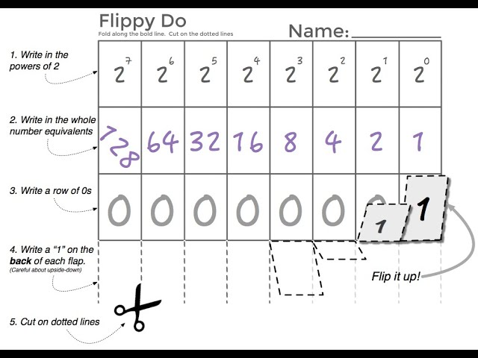
Activity: Part 3

Slide 12
Activity: Part 3
Use your flippy do to convert numbers
Flip up the “1” if the column will be completely filled, and leave the “0” if the column will be completely empty.
The number 10 will look like this:

Slide 13
Activity: Part 3
The number 10 will look like this:
8 + 2 = 10
2⁷ | 2⁶ | 2⁵ | 2⁴ | 2³ | 2² | 2¹ | 2⁰
128 | 64 | 32 | 16 | 8 | 4 | 2 | 1
0 | 0 | 0 | 0 | 1 | 0 | 1 | 0

Slide 14
Wrap-Up
Match the binary number with the decimal equivalent.
For a challenge, or extra practice, play the binary game.

